Slide 1
INVESTMENT CASE STUDY SUBMISSION
Group Name:
Balakrishna Gadiyar
Deepak Kumar Padhan
Bishnu Agrawal
Basavesh Hiremath

Slide 2
Abstract :
Spark Funds wants to make investments in a few companies.
Spark Funds have 2 minor constraints.
Invest between 5 to 15 million USD per round of investment
Invest only in English-speaking countries.
Business objective: The objective is to identify the best sectors, countries, and a suitable investment type for making investments. The overall strategy is to invest where others are investing, implying that the 'best' sectors and countries are the ones 'where most investors are investing'.

Slide 3
Problem solving methodology :
Investment type analysis:
Compare the Fund Type wise investment
Country analysis
Identify Top 3 Investment Countries
Sector analysis
Distribution of investments across the eight main sectors
Fund Type - venture, seed, angel, private equity etc.
Filter down to English Speaking Countries
Map each primary-sector to its main sector

Slide 4
Average Values of Investments for Each of these Funding Types :
Sl.No | Questions | Answer
1 | Average funding amount of venture type | 11.748 million USD
2 | Average funding amount of angel type | 0.958 million USD
3 | Average funding amount of seed type | 0.719 million USD
4 | Average funding amount of private equity type | 73.308 million USD
5 | Considering that Spark Funds wants to invest between 5 to 15 million USD per investment round, which investment type is the most suitable for them? | Venture

Slide 5
Analysing the Top 3 English-Speaking Countries :
Sl.No | Questions | Answers
1 | Top English speaking country | United States (USA)
2 | Second English speaking country | United Kingdom (GBR)
3 | Third English speaking country | India (IND)

Slide 6
Sector-wise Investment Analysis :
Sl.no | Questions | C1 | C2 | C3
1 | Total number of Investments (count) | 12012 | 619 | 328
2 | Total amount of investment (USD) | 107318.294 | 5365.228 | 2949.543
3 | Top Sector name (no. of investment-wise) | Others | Others | Others
4 | Second Sector name (no. of investment-wise) | Social, Finance, Analytics, Advertising | Social, Finance, Analytics, Advertising | Social, Finance, Analytics, Advertising
5 | Third Sector name (no. of investment-wise) | Cleantech / Semiconductors | Cleantech / Semiconductors | News, Search and Messaging
6 | Number of investments in top sector (3) | 2950 | 147 | 110
7 | Number of investments in second sector (4) | 2714 | 133 | 60
8 | Number of investments in third sector (5) | 2300 | 128 | 52
9 | For point 3 (top sector count-wise), which company received the highest investment? | virtustream | electric-cloud | firstcry
10 | For point 4 (second best sector count-wise), which company received the highest investment? | shotspotter | celltick-technologies | manthan-systems

Slide 7
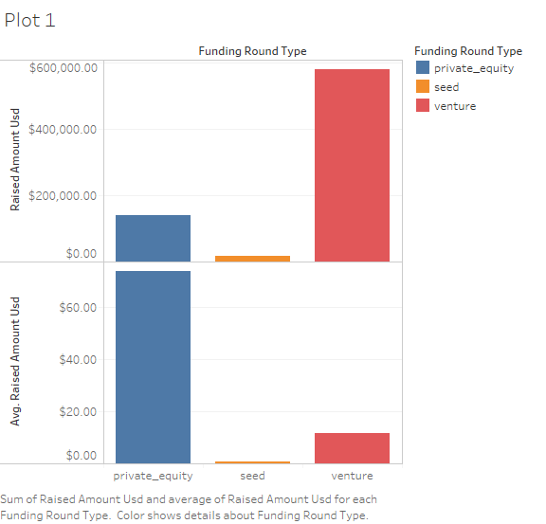
Funding type (FT) is best suited for Spark Funds :

Slide 8
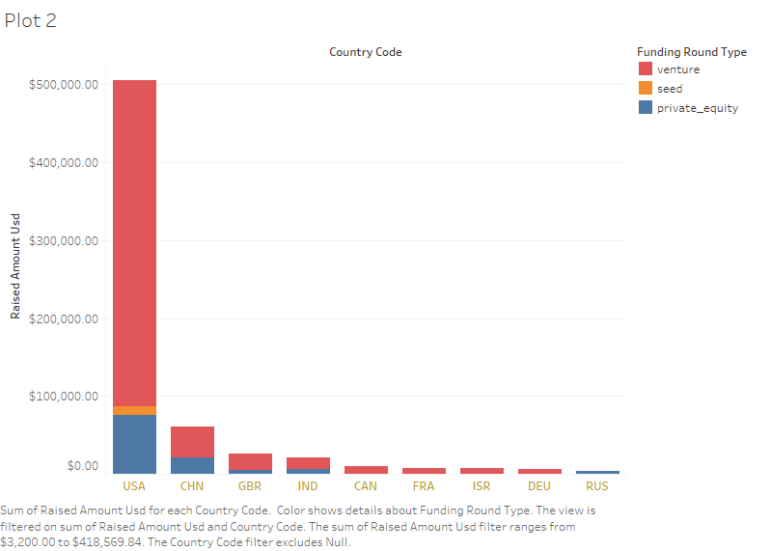
Top 9 countries against the total amount of investments of funding type :

Slide 9
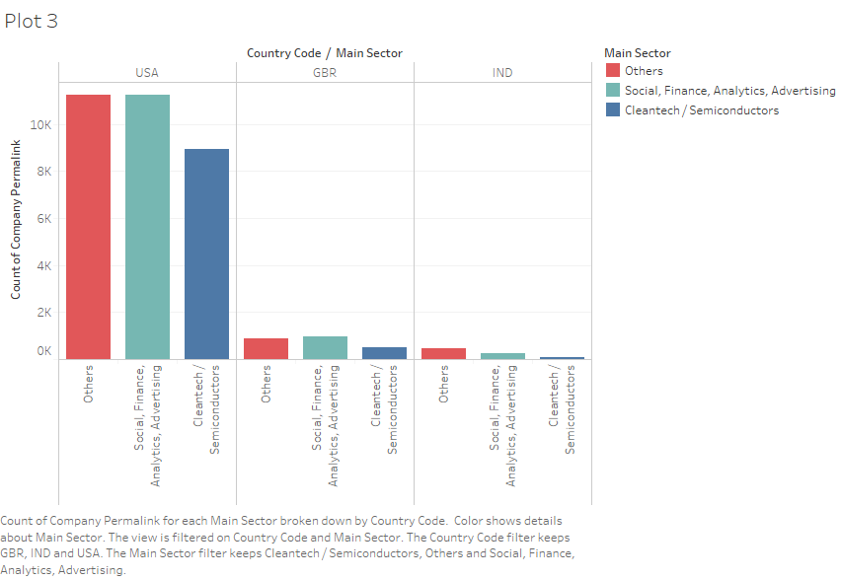
Number of investments in the top 3 sectors of the top 3 countries :

Slide 10
Conclusions :
Keeping the Business objective and the company’s constraint of Spark Fund, we came to the following conclusion.
The top 3 Funding Type are Ventures, Private Equity and Seed. This is based on the assumption that Spark Funds wants to invest 5 to 15 million USD per investment round.
Top 3 English Speaking Countries to Invest in would be USA, United Kingdom(GBR) and India. China also ranked 2nd as per the analysis but since it a non-speaking country, we can remove it from consideration.
Now moving further to identify the top 3 sectors as per the identified top 3 countries, it would be
Others
Social, Finance, Analytics, Advertising
Cleantech / Semi Counductors.

